Slide 1

How The Heck Do I Use GitHub?

Slide 2

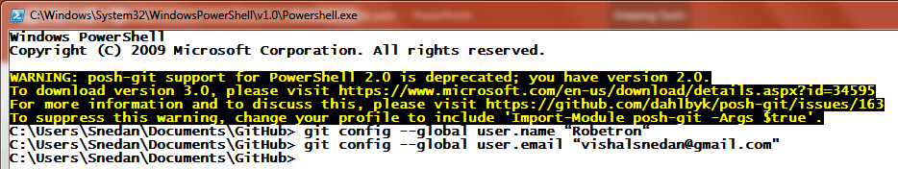
GIT SHELL
git config --global user.name "Your Name Here“
Eg: git config --global user.name “Robetron“
git config --global user.email "your_email@youremail.com"
Eg: git config --global user.email “vishalsnedan@gmail.com"

Slide 3
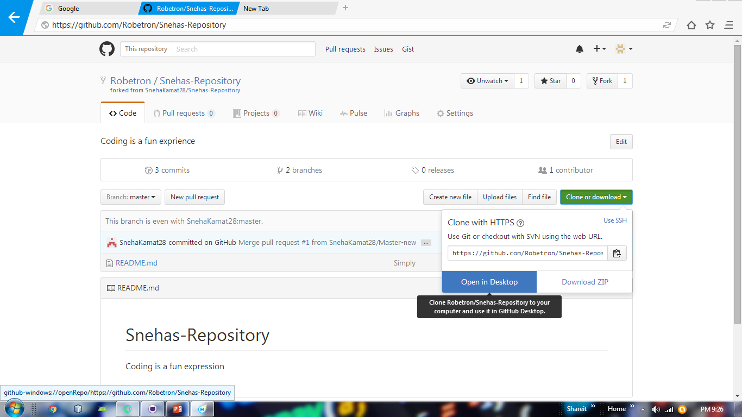
Fork It

Slide 4
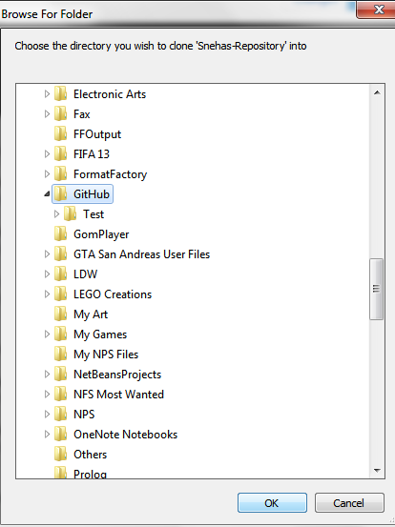
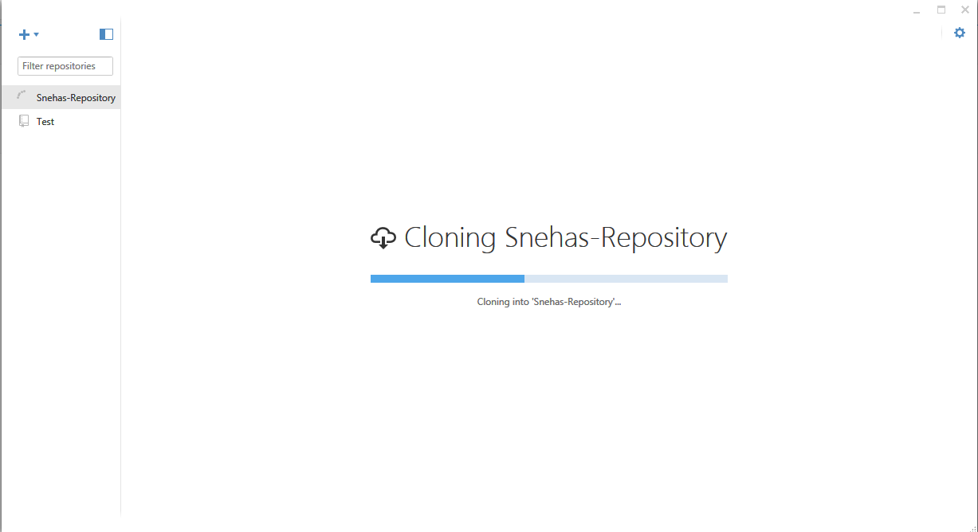
Clone It

Slide 5
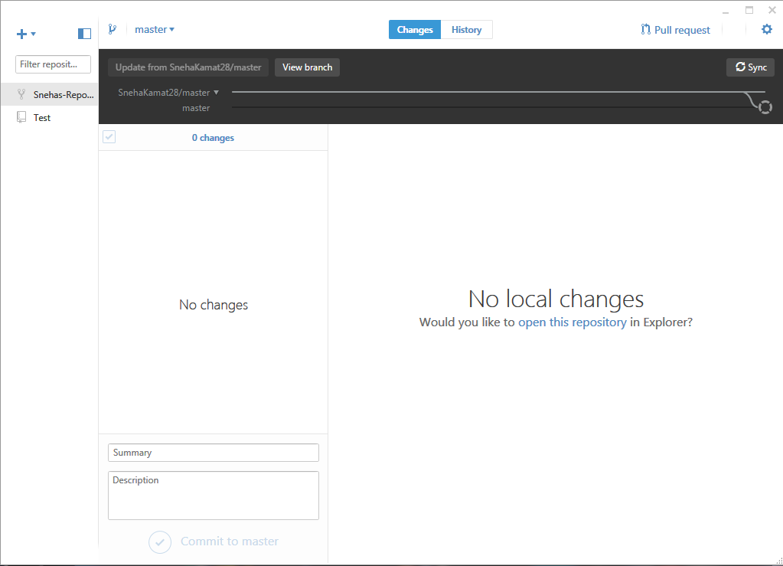
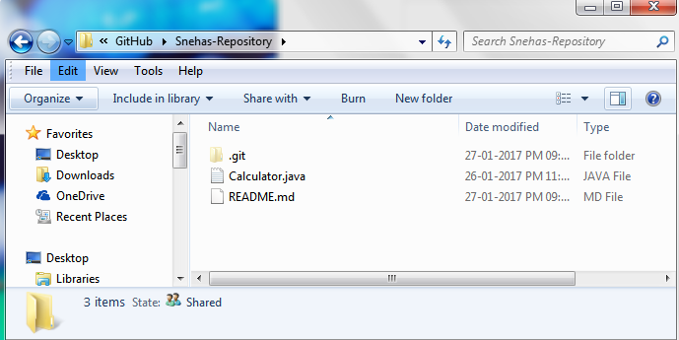
Change It

Slide 6
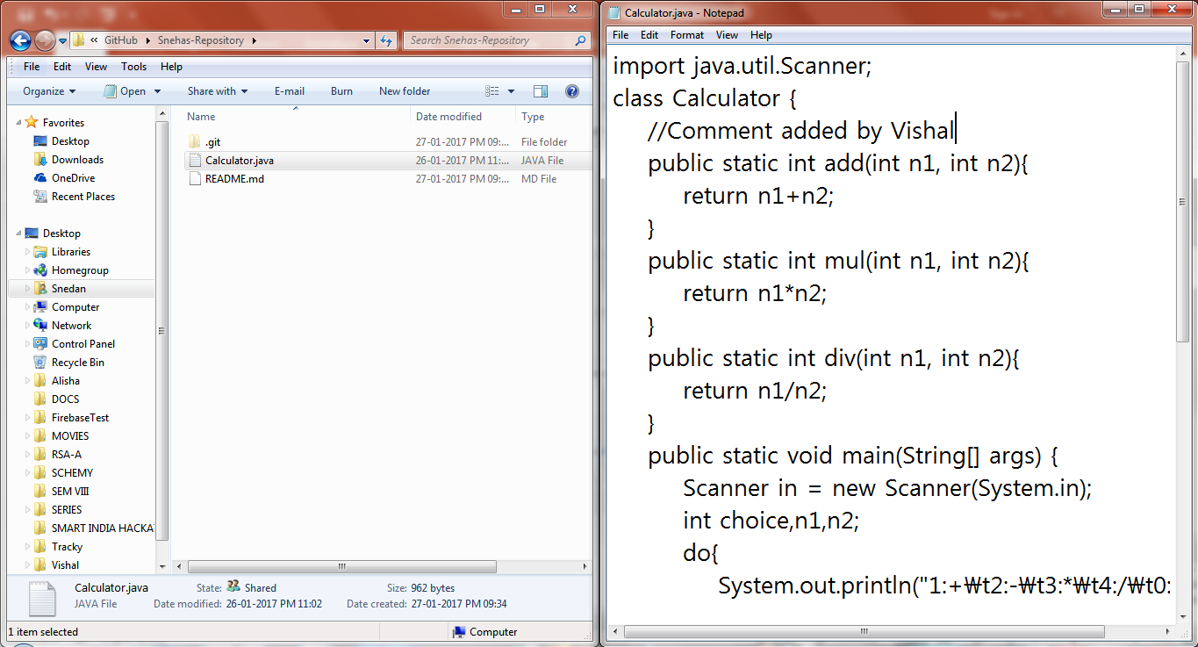
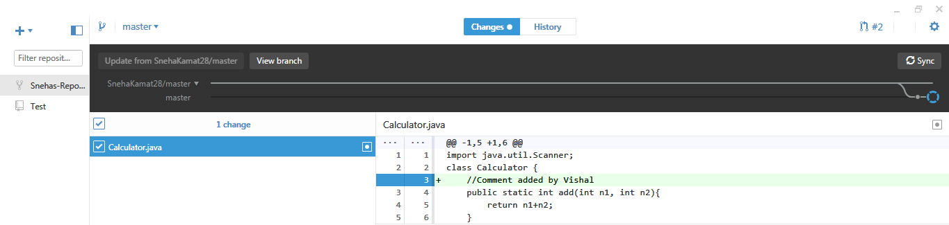

Slide 7
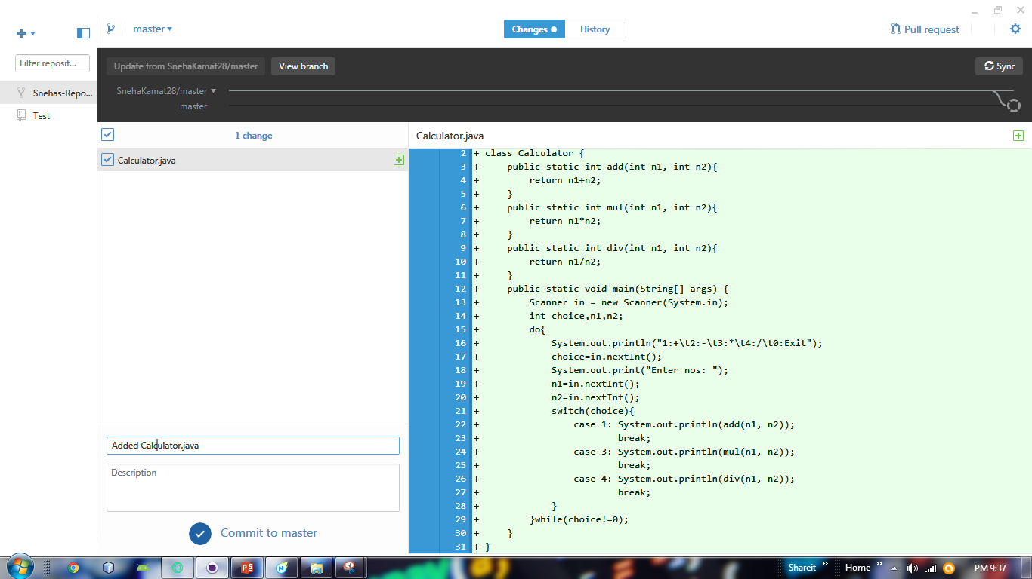
Commit It

Slide 8
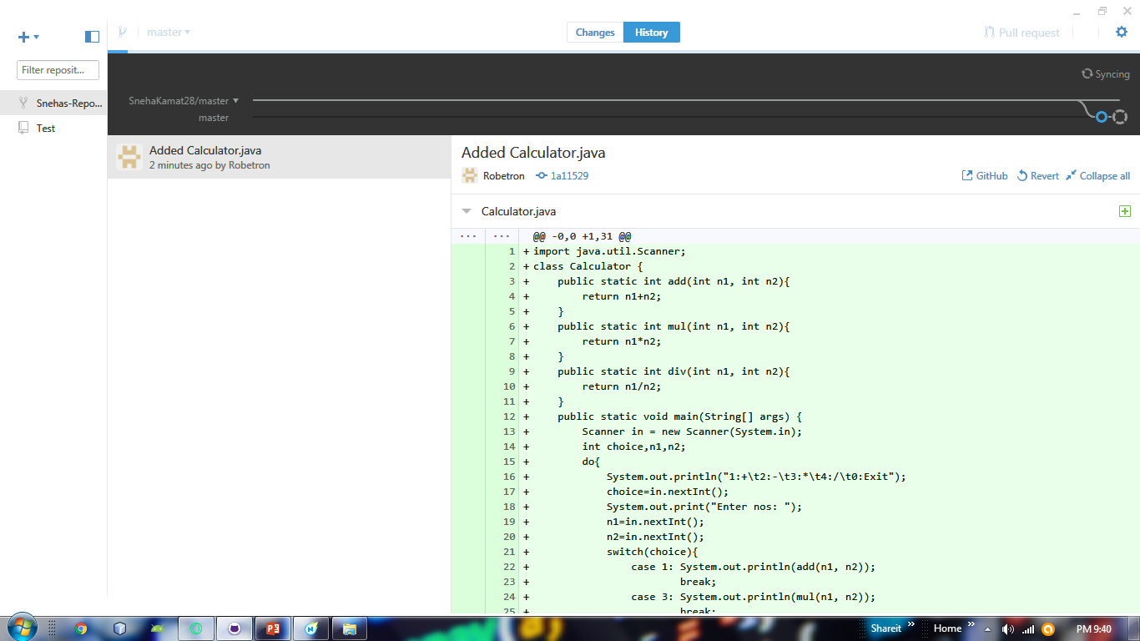
Sync It

Slide 9
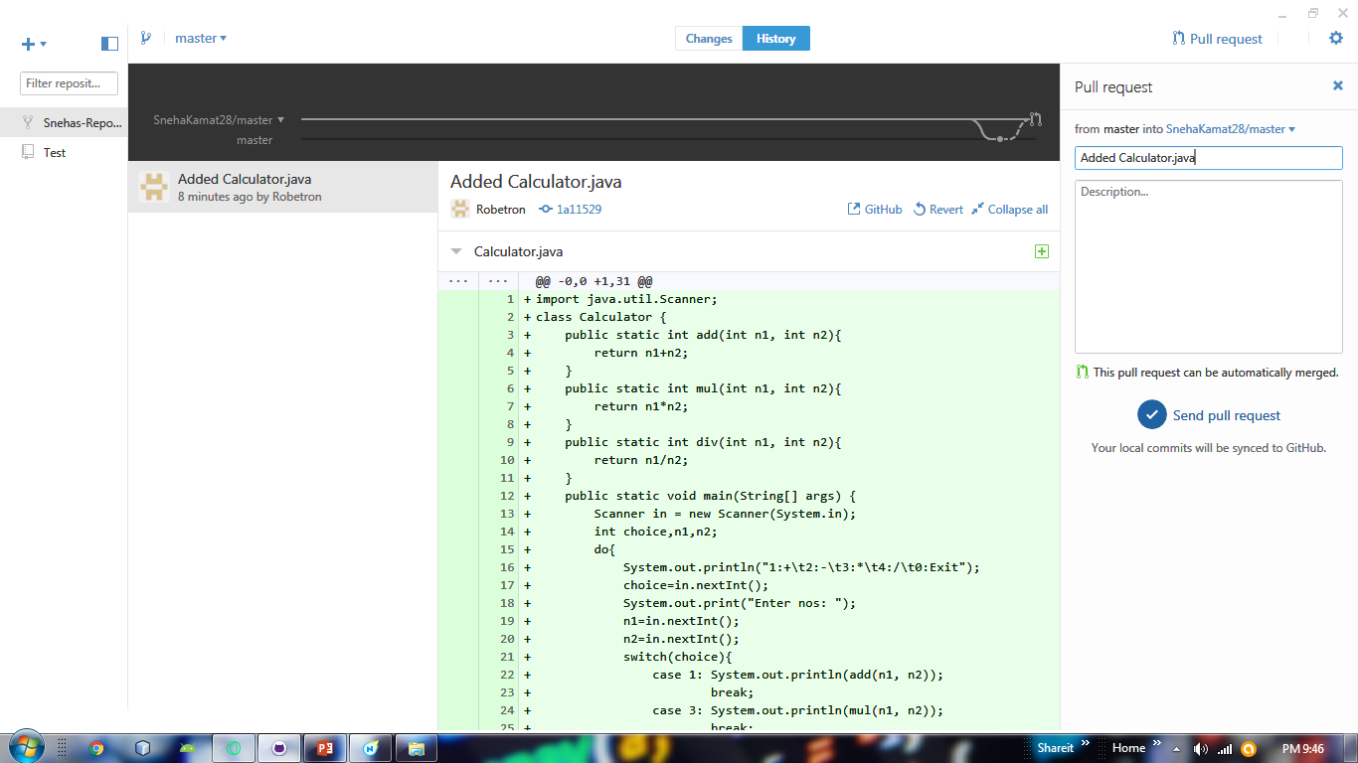
Pull It

Slide 10
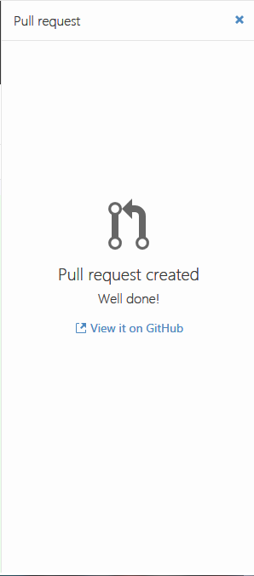
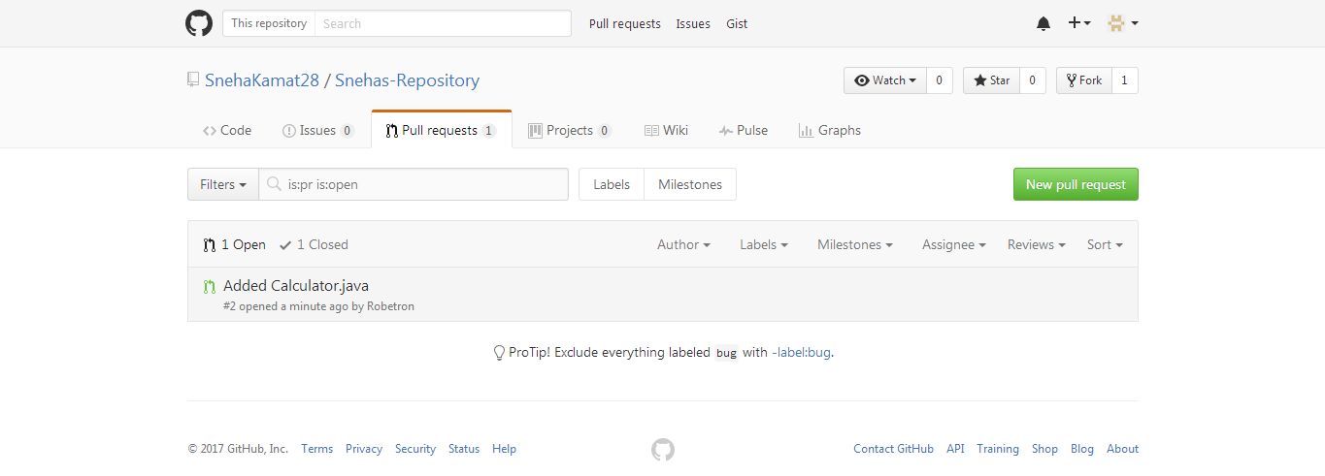
Check and
Wait for It…

Slide 11
Thank
You

